Slide 1

INSTITUTE :UIE
DEPARTMENT: ALL ACADEMIC UNITS
Bachelor of Engineering (All Sections)
Subject Name and Code:
Engineering Physics 23SPH-141
Prepared by: Dr. Anjana Sharma, Assistant Prof. Physics
CRYSTALLOGRAPHY & ULTRASONICS
DISCOVER . LEARN . EMPOWER

Slide 2
COURSE OBJECTIVES
The course is designed to make the students industry ready to contribute in the growing demand of the industry at local, national and international level.
It will make the students competent to understand basic concepts and applications of advanced engineering physics and apply its principles in their respective fields at global platform.
It will enhance the skill level of the students and shall make them preferred choice for getting employment in industry and research labs.
It will give thorough knowledge of the discipline to enable students to disseminate knowledge in pursuing excellence in academic areas.

Slide 3
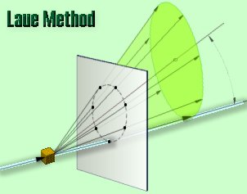
CRYSTAL STRUCTURE
Course Outcome
CO Number | Title On completion of this course, the students are expected to learn | Level
CO1 | Quote the basic fundamental concepts of lasers, optical fibres, crystallography, ultrasonic oscillations, semiconductor physics, quantum mechanics and nanotechnology. | Remember, Understand
CO2 | Demonstrate the working of various lasers, fibre components, semiconductor devices; explain the behaviour of crystalline solids, quantum and nano-scale systems. | Understand
CO3 | Solve problems by applying principles related to lasers, fibres, semiconductors, oscillations, quantum and nanoscience. | Applying
CO4 | Compare various lasers and fibres, semiconducting devices, crystalline materials, structures at quantum and nanoscale on the basis of their properties for industrial applications. | Analyze
CO5 | Develop various systems using lasers, fibres, semiconductors and nanomaterials for futuristic applications. | Design
Fig.1 Introduction[1]

Slide 4
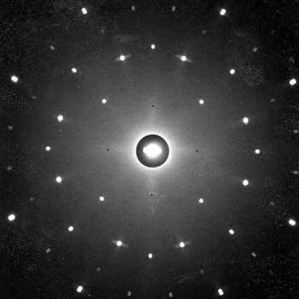
LAUE METHOD
Laue diffraction, in X-rays, a regular array of spots on a photographic emulsion resulting from X-rays scattered by certain groups of parallel atomic planes within a crystal.
Fig.2 Introduction[2]

Slide 5
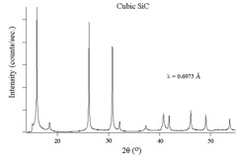
X-RAY METHOD
A diffraction pattern is obtained by measuring the intensity of scattered waves as a function of scattering angle. Very strong intensities known as Bragg peaks are obtained in the diffraction pattern when scattered waves satisfy the Bragg's Law.
Following Bragg's law, each dot (or reflection) in the diffraction pattern above forms from the constructive interference of X-rays passing through a crystal. The data can be used to determine the crystal's atomic structure.

Slide 6
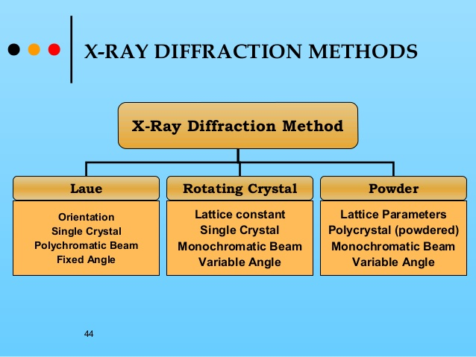
X-RAY METHOD
Fig.3 Methods [3]

Slide 7
TYPES OF LAUE METHOD
Transmission Method: In the transmission Laue method, the film is placed behind the crystal to record beams which are transmitted through the crystal.
b. Back Reflection Method: In the back-reflection method, the film is placed between the x-ray source and the crystal. The beams which are diffracted in a backward direction are recorded.

Slide 8
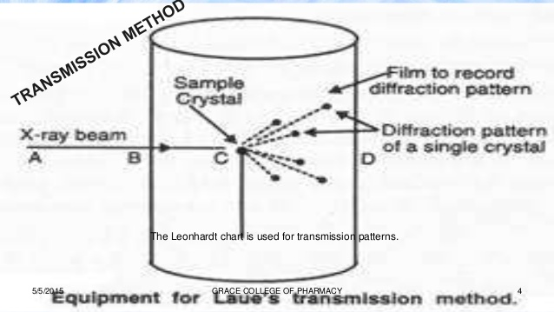
TRANSMISSION METHOD
Fig.4 Laue Method [4]

Slide 9
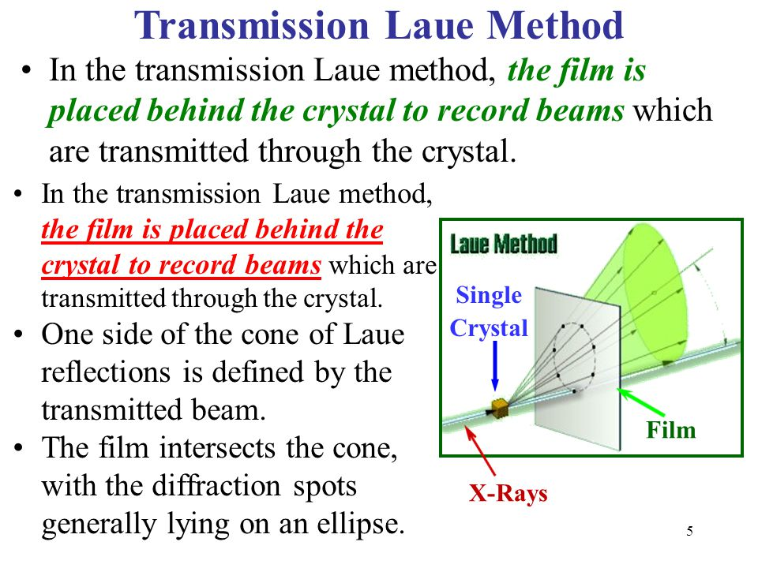
TRANSMISSION METHOD
Fig.5 Laue Method [5]

Slide 10
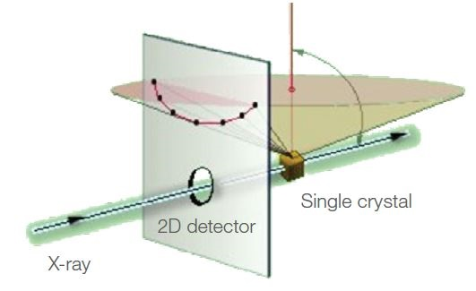
BACK REFLECTION METHOD
Fig.6 Laue Method [6]

Slide 11
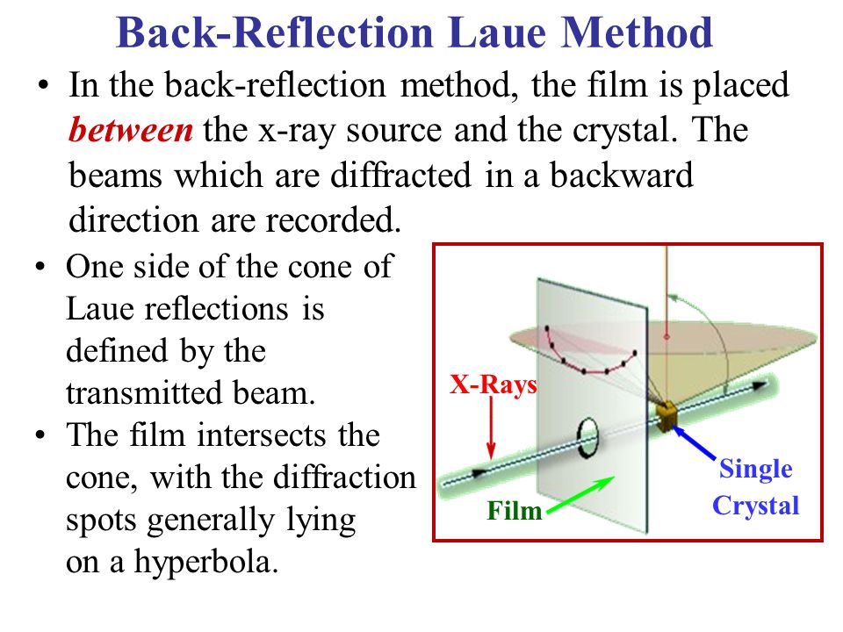
BACK REFLECTION METHOD
Fig.7 Laue Method [6]

Slide 12
ADVANTAGES AND DISADVANTAGES
The advantages of using Laue method of diffraction are that it is used for checking the orientation of crystals and their quality. It can be used for analyzing specimens that are thick and large.
The limitations of using this method are that it cannot be used for quantitative analysis because the wavelength of the X-ray beam that is causing a specific spot is unknown. Also, it requires a large crystal for analysis

Slide 13
SUMMARY
Introduction to LAUE Method
Working of Laue Method
Advantages and Disadvantages
Application

Slide 14
FAQS
What is difference between Powder and Laue method?
What is X-ray?
Why powder method is more beneficial than Laue method?
List advantages and disadvantages of Laue Method
What is the significance of Bragg’s law?
What is inverse piezoelectric method?
Draw plot of (100)

Slide 15
REFERENCES
[1 ] https://www.youtube.com/watch?v=fv1l-EIc4sM
[2] https://www.physics.nus.edu.sg/~L3000/Level3manuals/Laue%20Diffraction.pdf
[3] https://www.slideserve.com/wiley/chapter-3-x-ray-diffraction-in-crystal
[4] https://www.slideshare.net/grakbph040/laue-method
[5] https://slideplayer.com/slide/3866177/
[6] http://www4.hcmut.edu.vn/~huynhqlinh/project/Minhhoa3/Nhieuxa/Nx2/www.matter.org.uk/diffraction/x-ray/laue_method.htm
[7] http://www.ifm.liu.se/courses/tffm08/dloadsExfys/Lab31_Laue.pdf
[8] http://physicsopenlab.org/2018/01/18/laue-diffraction/
[9] https://en.wikipedia.org/wiki/Laue_equations

Slide 16
THANK YOU
For queries
Email: anjana.e1643@cumail.in

